Slide 1

Data Driven Applications
Web Applications
OBJECT ORIENTED PHP
Web Apps – L06

Slide 2
Learning Outcomes
You will be able to :
Design a PHP class.
Generate/create of objects based on your class.
Insert data into your objects.
Retrieve data from your objects.

Slide 3
Setup
Make sure your Apache server is running – check your XAMPP control panel
In your htdocs folder make sure there is a subfolder for this topic
Eg ..C:/xampp/htdocs/K00999999/T01
Download and unzip the code for this lecture to this folder
Start NETBEANS
Open the netbeans project for this lecture at this location

Slide 4
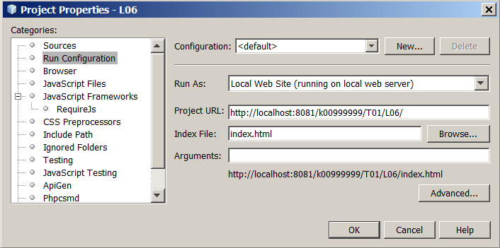
Configure NETBEANS project Properties
Right click on the project, select PROPERTIES/RUN CONFIGURATION
Set the PROJECT URL and index file to the correct one for your setup

Slide 5
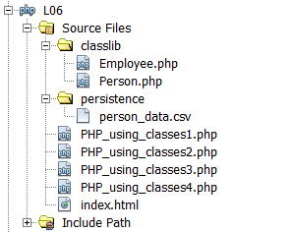
Project structure
Take note of the folder structure of this project
Class library
Other files used by the app

Slide 6
OO PHP
Like Java and C#, php finally has a complete OOP infrastructure.
We will learn by building an example
Open files PHP_using_classes1.php and classlib/Person.php

Slide 7
Creating a class
You define your own class by starting with the keyword 'class' followed by the name you want to give your new class.
Note – by convention the class name is capitalised and saved in a file of the same name.
class Person {
:
:
:
} //end class person

Slide 8
Add properties to the class
One of the big differences between functions and classes is that a class contains both data (variables) and functions that form a package called an: 'object'.
When you create a variable inside a class, it is called a 'property'.
class Person {
private $name;
:
:
} //end class person

Slide 9
Add Methods to the class
Functions defined in a class are called methods.
They are defined in the same way as regular PHP functions
In our example we will add ‘getter’ and ‘setter’ functions

Slide 10
Add Methods to the class
Functions defined in a class are called methods.
They are defined in the same way as regular PHP functions
class Person {
private $name;
function get_name() {
return $this->name;
}
function set_name($new_name) {
$this->name = strtoupper($new_name);
}
} //end class person

Slide 11
The '$this' variable
The $this is a built-in variable (built into all objects) which points to the current object.
$this is a special self-referencing variable.
You use $this to access properties and to call other methods of the current class.
function get_name() {
return $this->name;
}
Person.php

Slide 12
Include the class library in the main script
You would never create your PHP classes directly inside your main php pages – that would help defeat the purposes of object oriented PHP in the first place.
Instead, it is always best practice to create separate php pages that only contain your classes.
Then you would access your php objects/classes by including them in your main php pages with either a php 'include' or 'require'.
<?php include("classlib/Person.php"); ?>
PHP_using_classes1.php

Slide 13
Instantiate the object
When you instantiate a class, you create an instance of it, thus creating the object.
In other words, instantiation is the process of creating an instance of an object in the SERVER’s memory.
To create an object out of a class, you need to use the 'new' keyword.
$person1 is a handle/name for our new object
Multiple objects of the same class can be created
$person1 = new Person(“John Smith”,”12-Jan-2000”);

Slide 14
The ARROW operator
When accessing methods and properties of a class, you use the arrow (->) operator.
This is not the same operator as the one used with associative arrays (=>)
$objectName->method(); //access a method
$objectName->property; //access a property

Slide 15
Set an object’s properties
Now that we've created/instantiated a 'person' object, we can set its properties using the methods (the setters) we created.
$person1->set_name("John O’Brien");

Slide 16
Access an objects properties
we use the getter methods to access the data held in our objects …
$person1->get_name();

Slide 17
Don’t Directly access properties
You don't have to use methods to access objects properties; you can directly get to them using the arrow operator (->) and the name of the variable.
Though doable, it is considered bad practice to do it because it can lead to trouble down the road.
You should use getter methods instead
$person1->name;

Slide 18
Constructors
All classes can have a special built-in method called a 'constructor'.
Constructors allow you to initialize your object's properties when you instantiate (create) an object.
PHP will automatically call the __construct() method/function when you create an object from your class.
function __construct($persons_name,$dob)
{
$this->set_name($persons_name);
$this->set_dob($dob);
}

Slide 19
Constructors
The 'construct' method starts with two underscores (__) and the word 'construct'.
You 'feed' the constructor method by providing a list of arguments (like a function) after the class name.
$person1 = new Person(“John Smith”,”12-Jan-2000”);

Slide 20
Restricting Access to properties and methods
One of the fundamental principles in OOP is 'encapsulation'.
The idea is that you create cleaner better code, if you restrict access to the data structures (properties) in your objects.
You restrict access to class properties using something called 'access modifiers'.
There are 3 access modifiers:
public
private
protected
Public is the default modifier.

Slide 21
Access Modifiers - properties
When you declare a property as 'private', only the same class can access the property.
When a property is declared 'protected', only the same class and classes derived from that class can access the property - this has to do with inheritance
Properties declared as 'public' have no access restrictions, meaning anyone can access them.
private $name;
protected $date_of_birth;

Slide 22
Access Modifiers - methods
Like properties, you can control access to methods using one of the three access modifiers
public function get_name() {
return $this->name;
}
public function set_name($new_name)
{
$this->name = strtoupper($new_name);
}

Slide 23
Inheritance
Inheritance is a fundamental capability/construct in OOP where you can use one class, as the base/basis for another class … or many other classes.
Doing this allows you to efficiently reuse the code found in your base class.
Say, you wanted to create a new 'employee' class … since we can say that 'employee‘ is a type/kind of 'person', they will share common properties and methods.

Slide 24
Employee class
‘extends’ is the keyword that enables inheritance
class Employee extends Person
{
:
:
:
} //end class employee
Employee.php

Slide 25
Use the employee class
This script shows both classes in action
PHP_using_classes2.php

Slide 26
Persistence
Persistence of an object means to store it in non-volatile storage.
In this example we take the objects that we have created and store them as comma separated values in a file (.csv)
Note the use of the fopen() function with the or die construct.
This example illustrates that it is not possible to store an object methods – only its data members.
PHP_using_classes3.php

Slide 27
Reloading objects from persistent storage
This example re-constructs the objects we saved in the previous example.
PHP_using_classes4.php

Slide 28
References
PHP Manual - http://php.net/manual/en/language.oop5.php

